Slide 1

Predicting Churn Customers
Group I

Slide 2

Problem Statement
The bank is facing an issue with an increasing number of customers leaving their credit card services (churning).
To proactively address this problem, the bank aims to develop a predictive model that can identify which customers are likely to churn.
Proactive Customer Retention (Motivation): Identify potential churners early and take proactive actions, such as offering tailored services, incentives, or retention strategies, to prevent them from leaving.
By identifying potential churners in advance, the bank can take proactive measures to retain these customers by offering improved services or incentives, ultimately reducing the churn rate and enhancing customer retention.

Slide 3
Previous and current studies on this topic
Numerous people have conducted studies on this dataset and have identified the following findings:
The T-tests comparing attritioned and existing customer datasets revealed statistically significant differences in credit limit, revolving balance limits, and revolving ratios.
Factors such as income, gender, and education level did not contribute much to customer churn.
Long term customers become less costly to serve, they generate higher profits, and provide new referrals. The cost of attracting new customers could be six times more than holding on to existing customers – therefore, we should do our best to reduce attritioning customers

Slide 4

Opportunity available in using BA
Informed Decision-Making: Business analytics enables organizations to make strategic decisions based on data analysis, reducing reliance on intuition and improving overall decision quality.
Operational Efficiency: By analyzing operational data, organizations can identify inefficiencies, streamline processes, and optimize resource allocation, leading to increased operational efficiency and cost savings.
Competitive Advantage and Innovation: Effective use of business analytics provides a competitive edge by enabling organizations to identify market trends, consumer behavior, and innovation opportunities, fostering a data-driven approach to stay ahead in the marketplace.

Slide 5

Data source
The dataset was sourced from Kaggle. It encompasses a comprehensive set of columns providing valuable insights into credit card customers' profiles and behaviors.
The key columns include:
Customer Information:
Customer Age, gender, dependent count, education level, marital status, income category
Account and Card Details:
Months on book, total changing amount, credit limit, total revolving balance, total transfer amount, average utilization ratio
Transaction History (throughout the year):
Months Inactive, contacts count, total amount change, total transaction amount, total transaction count, total count change

Slide 6
Data Set
Overview of Data
Data Source: https://www.kaggle.com/sakshigoyal7/credit-card-customers
A total of 10,127 records of customers
Credit Card Customers falling into 2 categories
Existing Customers
Attritioned Customers
23 different variables storing details about the customer
7 categorical features
14 Numerical features
Two columns are recommended to be removed; therefore, those are not being considered

Slide 7
Data Set
Variable Name | Numerical or Categorical | Brief Description
Customer_id | Categorical | Unique Customer Identifier
Attrition_Flag | Categorical | Account Closed or Open
Gender | Categorical | Male or Female
Education_level | Categorical | High school, College, doctorate…
Marital_Status | Categorical | Married, Single, divorced
Income_Category | Categorical | Different income slabs
Card_Category | Categorical | Category of credit cards
ClientNum | Numerical | Derived value of customer id
Customer_Age | Numerical | Age of the Customer
Dependent_Count | Numerical | Number of Dependents
Months_on_Book | Numerical | Period of Relationship with bank

Slide 8
Data Set
Variable Name | Numerical or Categorical | Brief Description
Total_Relationship_Count | Numerical | Total Products held by Customer
Months_Inactive_12_Mon | Numerical | Inactive months in last 12 months
Contacts_Count_12_Mon | Numerical | No. of Contacts in last 12 months
Credit_Limit | Numerical | Credit card credit limit
Total_Revolving_Bal | Numerical | Amount owed to the Company
Avg_Open_To_Buy | Numerical | Open to buy Credit line
Total_Amt_Chng_Q4_Q1 | Numerical | Change in transaction Amt
Total_Trans_Amt | Numerical | Change in Transaction Amount
Total_Trans_Ct | Numerical | Total Transaction Count
Total_Ct_Chng_Q4_Q1 | Numerical | Change in Transaction Count
Avg_Utilization_Ratio | Numerical | Average Card Utilization Ratio

Slide 9
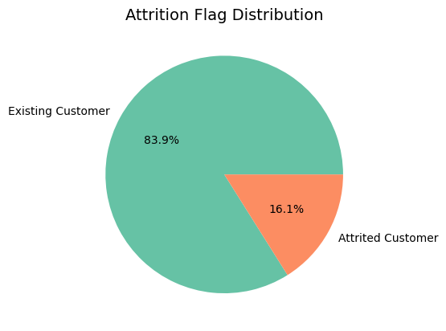
Exploratory Analysis

Slide 10
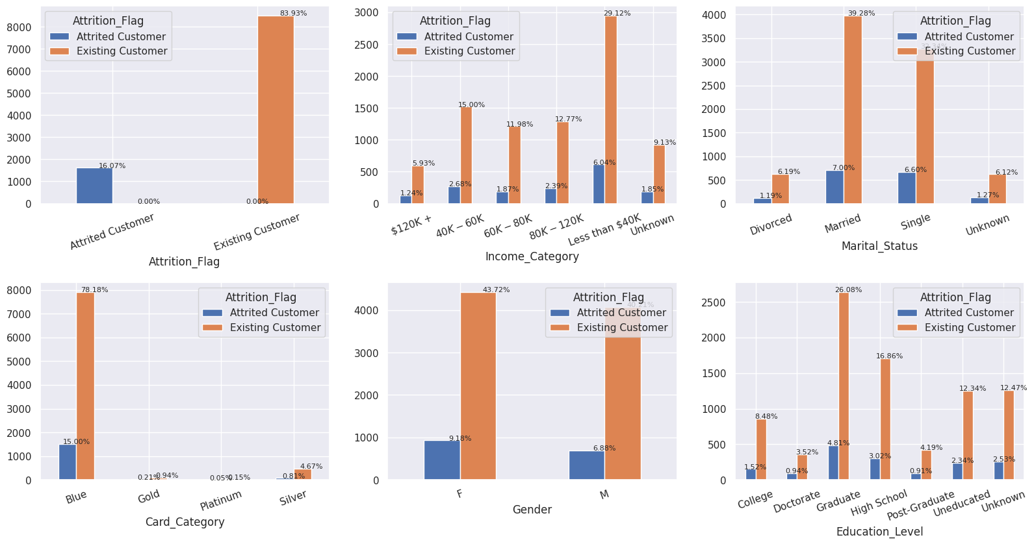
Categorical Variables
Analysis
Among the clients who have discontinued their services, 93.17% possess a Blue card.
35.15% of the clients who have stopped using the services have an annual income of less than $40K.
46.28% of the clients who have ended their services are married.
30.88% of the clients who have discontinued their services hold a graduate education level.

Slide 11
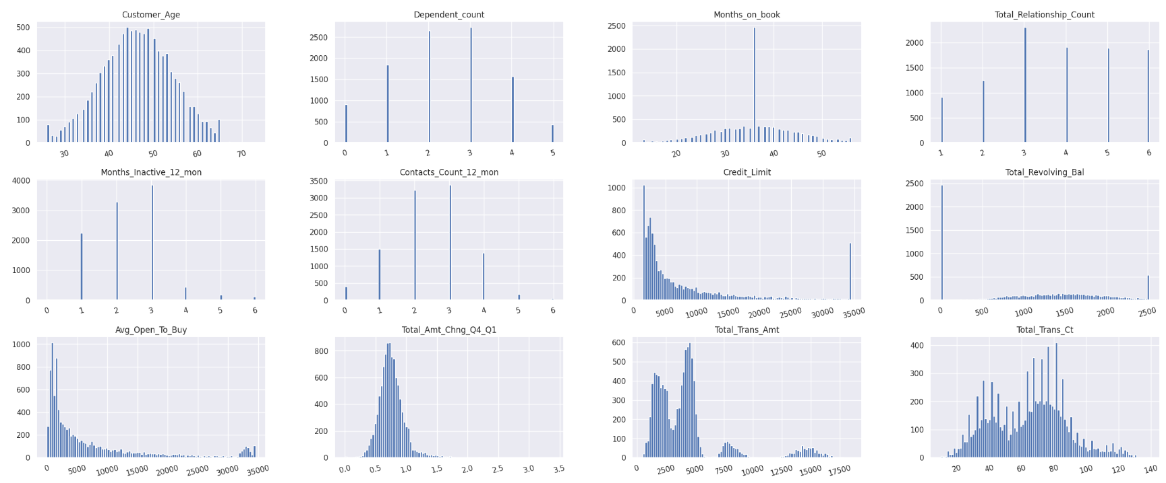
Numerical Variables
Analysis
Customers between 40 and 50 years old are the highest in number
Most number of customers are associated with the bank for 2-4 years
Majority of the transactions done are below $5K
Individuals who terminated their credit card service had lower transaction counts and transaction amounts.

Slide 12
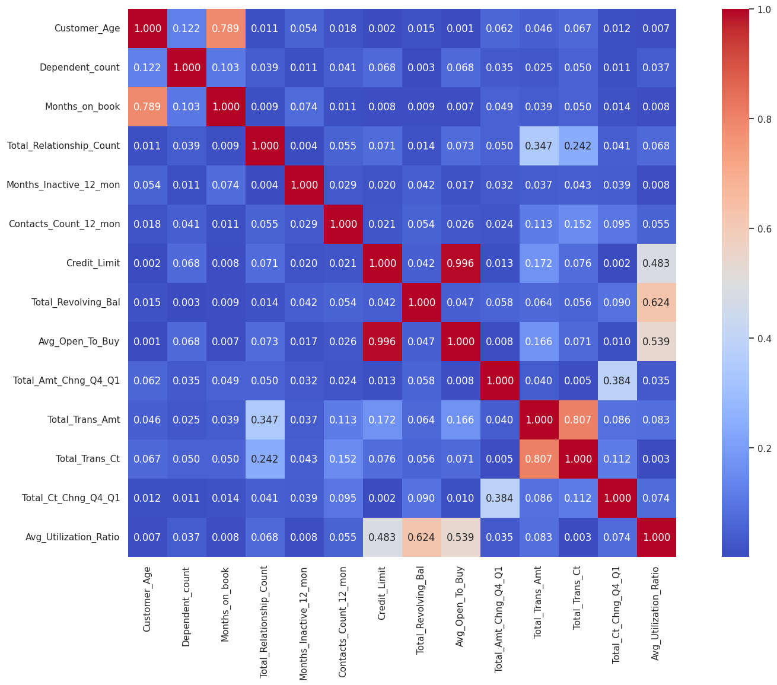
Checking Correlation
Analysis
It appears that there is a correlation between the length of time as a customer (Months_on_book) and the customer's age.
Moreover, there is a correlation between the Total Transaction Count and the Total Transaction Amount.

Slide 13
Data Preprocessing
The following steps were taken to prepare the data
Numerical values were assigned to the following Categorical variables
Attrition_Flag (Name Changed to Churn)
Existing Customers – 0
Churned Customers - 1
Income_Category
'Unknown’: 0
'Less than $40K’:1
'$40K - $60K’:2
'$80K - $120K’:3
'$60K - $80K’:4
'$120K +’:5
Data type were changed to int and dummy variables were added for categorical features

Slide 14
Models Used
Logistics Regression
Ridge Classifier
Random Forest Classifier
KNN Classifier
Decision Trees
XGBoost
Parameter Tuning

Slide 15
Test Results
Logistic Regression
Baseline Accuracy: 0.8409479921000658
Train Accuracy : 0.892034233048058
Test Accuracy: 0.8830963665086888
Classification threshold is 0.5
True Positive Rate/Recall = 0.45584725536992843
False Positive Rate = 0.03218173213440606
Accuracy = 0.8830963665086888
Precision = 0.7374517374517374
F1 score: 0.5634218289085546
ROC AUC score: 0.7118327616177612
Predicted
Negative
Positive
Negative
2045
68
Confusion Matrix
Actual
Positive
228
191

Slide 16
Test Results
Ridge Classifier
Train Accuracy : 0.8986175115207373
Test Accuracy: 0.9048183254344392
Classification threshold is 0.5
True Positive Rate/Recall = 0.4742014742014742
False Positive Rate = 0.012705882352941176
Accuracy = 0.9048183254344392
Precision = 0.8772727272727273
F1 score: 0.6156299840510367
ROC AUC score: 0.7307477959242666
Predicted
Negative
Positive
Negative
2098
27
Confusion Matrix
Actual
Positive
214
193

Slide 17
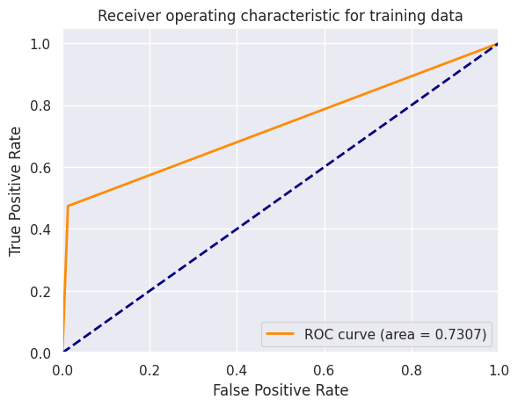
Test Results
Ridge Classifier (ROC Curve)

Slide 18
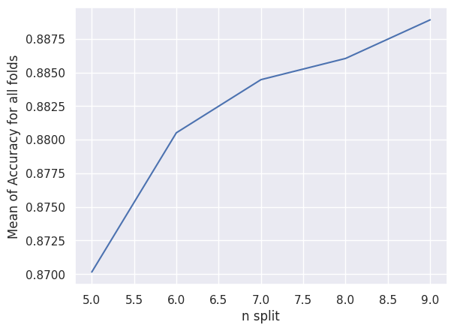
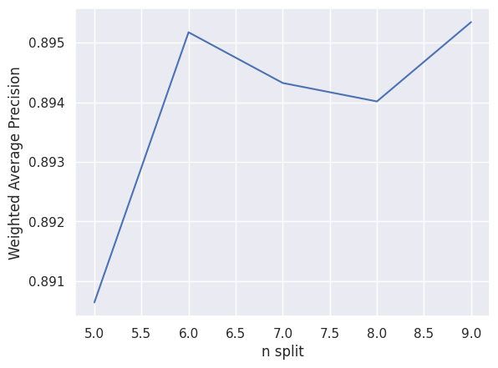
Test Results
Ridge Classifier (Parameter Tuning)

Slide 19
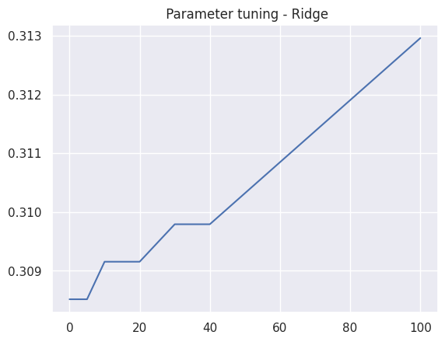
Test Results
Ridge Classifier (Parameter Tuning)

Slide 20
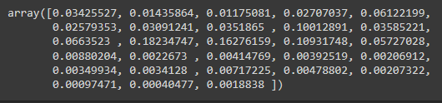
Test Results
Random Forest
Random Forest Accuracy: 96.25%
Classification threshold is 0.5
True Positive Rate/Recall = 0.8230958230958231
False Positive Rate = 0.010823529411764706
Accuracy = 0.9624802527646129
Precision = 0.9357541899441341
F1 score: 0.8758169934640523
ROC AUC score: 0.9061361468420291
Predicted
Negative
Positive
Negative
2102
23
Confusion Matrix
Actual
Positive
72
335

Slide 21
Test Results
Random Forest Classifier (Parameter Tuning)
Classification threshold is 0.5
True Positive Rate/Recall = 0.8402948402948403
False Positive Rate = 0.010352941176470589
Accuracy = 0.9656398104265402
Precision = 0.9395604395604396
F1 score: 0.8758169934640523
ROC AUC score: 0.9061361468420291
Train Accuracy : 0.9984200131665569
Test Accuracy: 0.9656398104265402
Predicted
Negative
Positive
Negative
2103
22
Confusion Matrix
Actual
Positive
65
342

Slide 22
Test Results
KNN Classifier
N=14
Train Accuracy : 0.8886109282422646
Test Accuracy: 0.877172195892575
Classification threshold is 0.5
True Positive Rate/Recall = 0.2727272727272727
False Positive Rate = 0.007058823529411765
Accuracy = 0.877172195892575
Precision = 0.8809523809523809
F1 score: 0.8758169934640523
ROC AUC score: 0.9061361468420291
Predicted
Negative
Positive
Negative
2110
15
Confusion Matrix
Actual
Positive
296
111

Slide 23
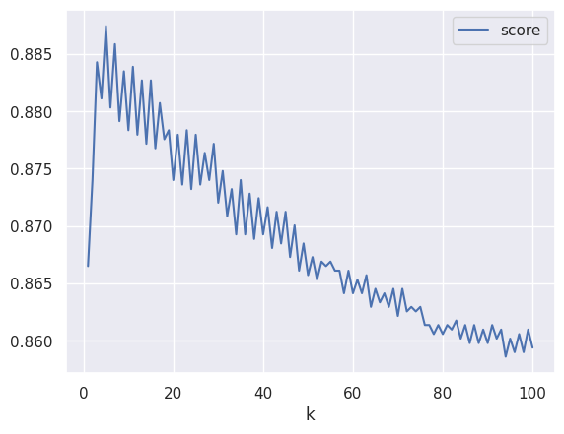
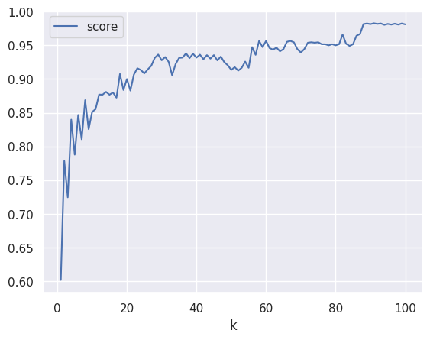
Test Results
KNN Classifier
K = 5: Max Accuracy
K = 99: Max Precision

Slide 24
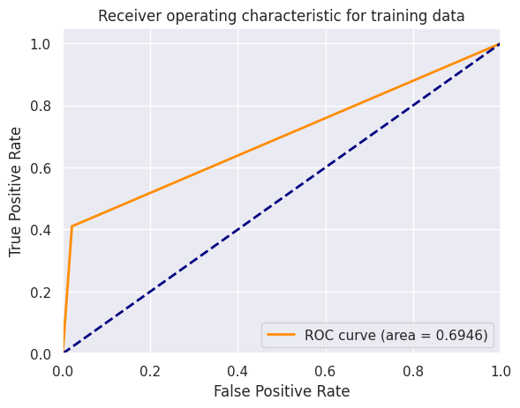
Test Results
KNN Classifier (ROC Curve)
Classification threshold is 0.5
True Positive Rate/Recall = 0.4103194103194103
False Positive Rate = 0.021176470588235293
Accuracy = 0.8874407582938388
Precision = 0.7877358490566038
F1 score: 0.8758169934640523
ROC AUC score: 0.6946361468420291

Slide 25
Test Results
KNN Classifier
Train Accuracy : 0.9182356813693219
Test Accuracy: 0.8874407582938388
Classification threshold is 0.5
True Positive Rate/Recall = 0.4103194103194103
False Positive Rate = 0.021176470588235293
Accuracy = 0.8874407582938388
Precision = 0.7877358490566038
F1 score: 0.8758169934640523
ROC AUC score: 0.9061361468420291
Predicted
Negative
Positive
Negative
2080
45
Confusion Matrix
Actual
Positive
240
167

Slide 26
Test Results
Decision Trees
Accuracy : 96.25%
Classification threshold is 0.5
True Positive Rate/Recall = 0.1547911547911548
False Positive Rate = 0.15529411764705883
Accuracy = 0.7338072669826224
Precision = 0.16030534351145037
F1 score: 0.5395799676898223
ROC AUC score: 0.6945714698655875
Predicted
Negative
Positive
Negative
1795
330
Confusion Matrix
Actual
Positive
344
63

Slide 27
Test Results
XG Boost
Train Accuracy : 0.9863067807768269
Test Accuracy: 0.9770932069510269
Classification threshold is 0.5
True Positive Rate/Recall = 0.914004914004914
False Positive Rate = 0.010823529411764706
Accuracy = 0.9770932069510269
Precision = 0.9417721518987342
F1 score: 0.5395799676898223
ROC AUC score: 0.9516714698655875
Predicted
Negative
Positive
Negative
2102
23
Confusion Matrix
Actual
Positive
35
372

Slide 28
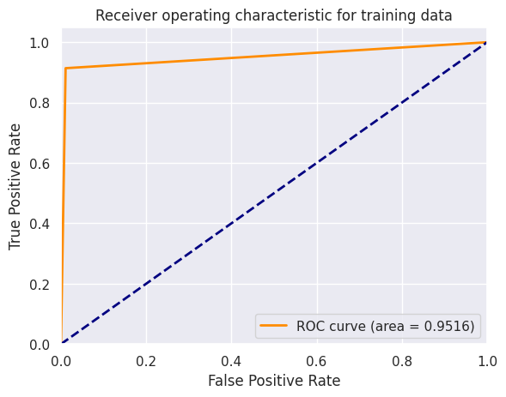
Test Results
XG Boost

Slide 29
Outcomes
These customer features appear to standout as drivers in customers leaving credit services:
Age increases
Utilization/Transactions decrease
Low credit limit issuance

Slide 30
Recommendations
Using XG Boost to find out the features that are most impacting the churn. We identified some of the important features that has significant impact on customer credit card churn.
Design/target programs to decrease the chances of customers leaving while added customers:
Age
Utilization/Transactions decrease
Credit limit decreases
We cannot control a person's age, force them to spend money or get them to use more of their credit. However, services can be set to encourage use. Student loan and supply credit cards to bring in younger customers. For seniors, credit lines can be extended to allow for discounts on medical costs when placed on the charge card.

Slide 31
Recommendations
Connect with the customer regularly (through surveys for example), and provide the customer with various offers and schemes to increase relationships of the customer with the bank (low interest fees, online credit cards with applied promo codes)
Bank should offer cashback schemes on credit cards to show incentive
Bank should also offer credit limit increase for the customers who are regularly using the credit card.

Slide 32

Q&A any questions?

